Slide 1
Import Excel
EXCEL FILE
1
2
3
Correct Products List
Error Products List
Duplicate Products List

Slide 2
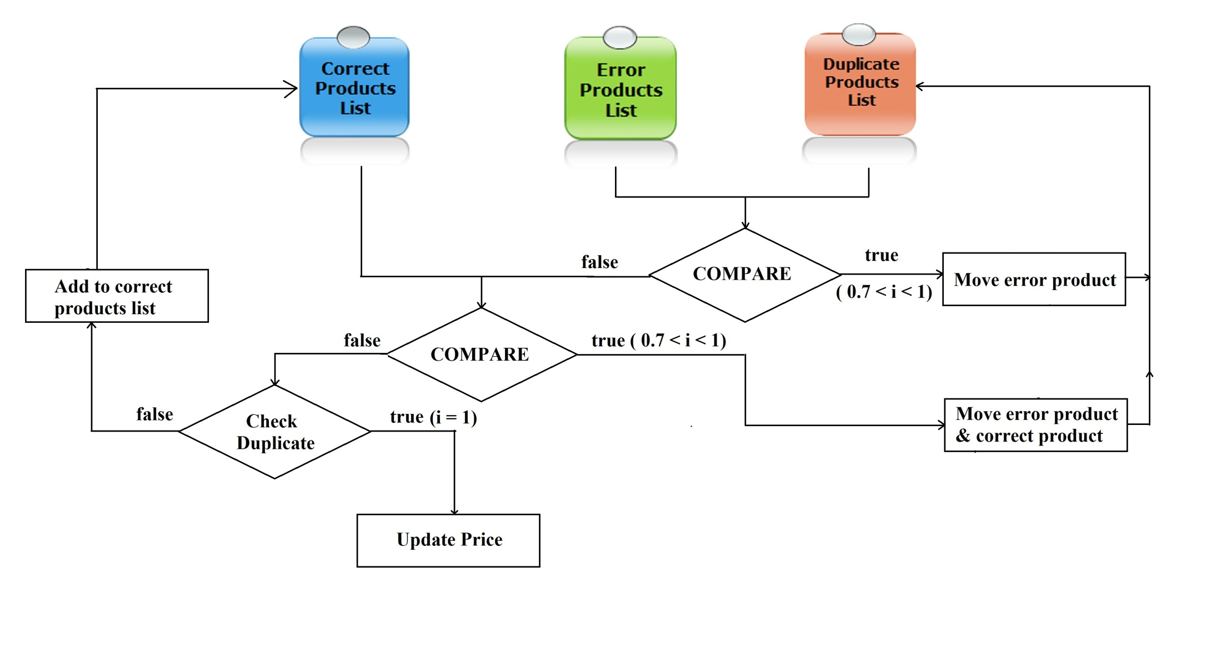
Error products

Slide 3
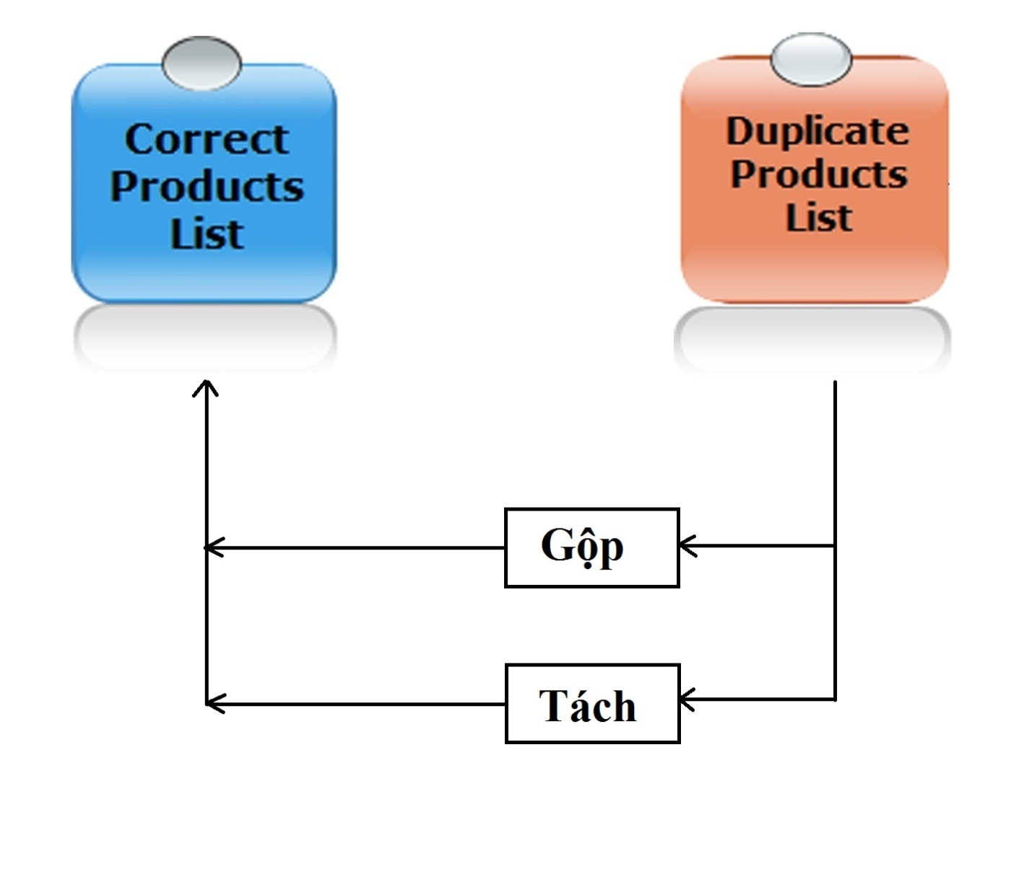
Duplicate products

Slide 4
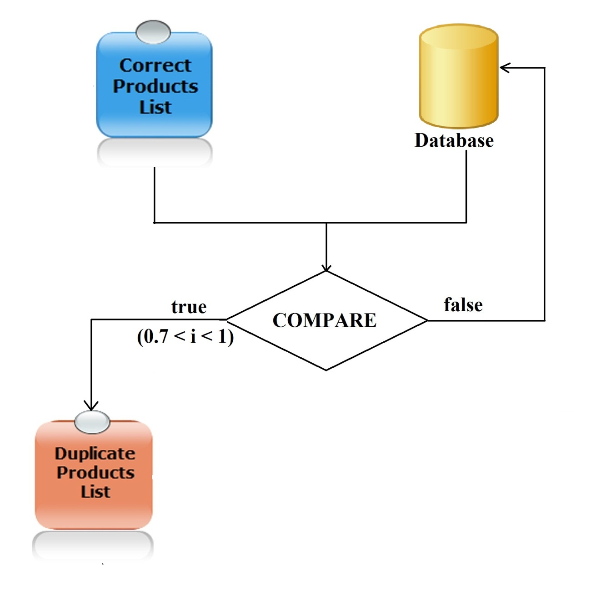
Correct products

